Slide 1
Quarterly Update on the National Inventory Collaborative
June 20, 2018

Slide 2
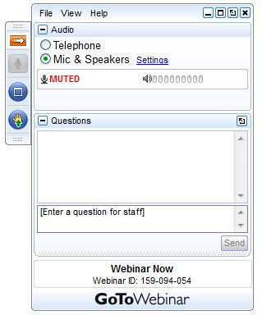
Webinar Ground Rules: Questions?
Each workgroup will give an update introducing their group and their plans for the coming months.
All call participants will remain on mute during the webinar.
Type your questions into the question box on the webinar client.
We will try to answer questions at the end of the webinar.
We will create a Q&A document following the webinar and post with the meeting notes on the Collaborative Wiki: http://views.cira.colostate.edu/wiki/wiki/9169

Slide 3
Overview of the Platform Collaborative
A new multi-purpose emissions modeling platform (EMP) based on the 2014 National Emissions Inventory version 2 (2014NEIv2) is needed
  State Implementation Plans, federal analyses
  For the first time, EPA, states, and MJOs are engaging in collaborative EMP development
  The 2016 base year was selected via a collaborative process
Future years selected due to regulatory relevance
  2023 is relevant for Ozone NAAQS moderate areas
    Although 2020 is relevant for marginal areas, modeling is not required for marginal areas
  2028 for regional haze

Slide 4
2016 EMP Schedule
Several versions of 2016 platform will be developed
  Alpha: preliminary version based on 2014NEIv2 for some and 2016 for other key sectors (released March-April, 2018)
    ftp://newftp.epa.gov/Air/emismod/2016/alpha/
    Compatible versions of 2014 and 2015 were also released
    For initial testing of 2016 model runs
  Beta: improved and/or new version of actual 2016 emissions for most sectors and preliminary projected emissions to 2023 and 2028 (Summer-Fall, 2018)
  V1.0: fully updated 2016 emissions and complete projected emissions for 2023 and 2028 (Winter, 2019)
Schedule overlaps with 2017 NEI Development
  Prioritize the 2017 NEI over the 2016 platform, as needed
  Any missing data for 2016 will be filled in based on 2014 NEI data and nationally consistent methods

Slide 5
Organizational Structure
Coordination co-leads: Zac Adelman (LADCO) and Alison Eyth (EPA OAQPS)
  Developed process and communication structures, facilitate discussions, help resolve issues, documentation requirements, coordinate distribution of data to stakeholders
Coordination committee: regional, state, EPA leaders
  Define processes, resolve issues, co-lead workgroups
  Includes overall and WG co-leads plus MJO directors
Sector-specific Workgroups: one regional/state staff and one EPA staff (where possible)
  Focus on preparing emissions estimates for 2016 and future years, plus improve how the emissions sectors are modeled
  Include participants from EPA/states/locals/regions

Slide 6
Collaborative Workgroup Reports
EGUs
Non-EGU Point
Nonpoint
Oil and gas sources (point and nonpoint)
Onroad
Nonroad
Rail
Commercial Marine Vessels (CMV)
Fires
Biogenics
Modeling
Wrap up
Wiki has more information and notes from each workgroup
  http://views.cira.colostate.edu/wiki/wiki/9169

Slide 7
Electricity Generating Units (EGUs) Workgroup
Co-leads: Julie McDill (MARAMA), Serpil Kayin (EPA), Alison Eyth (EPA)
Schedule: Calls on 4th Thursday at 2:00pm Eastern
Wiki: http://views.cira.colostate.edu/wiki/wiki/9174
Status of the 2016 Beta Inventory
  Base Year
  Projections using ERTAC EGU
  Projections using IPM

Slide 8
EGU Workgroup: 2016 beta
Approach
  2016 emissions for Type A sources submitted through January
  EPA notified submitters of potential QA concerns and issues were corrected
  EPA compiled the submissions into a draft point inventory (alpha) and processed through SMOKE including matching to 2016 CEMS data
  Draft 2016 point inventory was made available in EIS and via FTP for review
  States submitted revisions to the inventory through May 15
  States and EPA worked together to update EIS unit matches to CEMS data (CAMD/ORIS IDs) and to NEEDS IDs (to separate EGUs from non-EGUs)
  Updated matches were entered into EIS
Status
  EPA compiled an updated 2016 point inventory now available in EIS and soon to be available by FTP
Next Steps for 2016 EGUs
  Review split of inventory into EGUs and non-EGUs
  Prepare a cross walk to specify units modeled by IPM and ERTAC EGU
  Determine temporal allocation approach (CEMS, small EGUs, MWCs, cogens)

Slide 9
2014 and 2016 EGU Summary
There was a substantial EGU NOx and SO2 drop from 2014-2016
The vast majority of EGU emissions are from units with CEMS

Slide 10
EGU Workgroup: ERTAC EGU
MJOs are preparing 2023 and 2028 EGU projections via ERTAC EGU. Draft versions of 2023 and 2028 will be provided for state review on outreach calls on June 26 & 27.
Two webinars being offered to review the data with states
Tuesday, June 26, 2018 at 2:00 PM EDT - Registration URL:
  https://attendee.gotowebinar.com/register/8257616389972365825
Wednesday, June 27, 2018 at 2:00 PM EDT - Registration URL:
  https://attendee.gotowebinar.com/register/6154192371920648449
State feedback deadline August 1, 2018

Slide 11
EGU Workgroup: EPA’s Power Sector Modeling using IPM v6
IPM v6 positions EPA to more effectively address newly emerging power sector drivers, including:
  Significant penetration of variable renewable energy (VRE)
  Greater value of — and demand for — energy storage
  Building capability to model electrification scenarios
In addition to architectural improvements, improved the experience of interacting with IPM
  Reworked documentation
  Improved run output files
  Multiple scenarios
  IPM Results Viewer
Suite of scenarios with respect to the initial run
  High Demand Case
  Low Demand Case
  Higher NG Cost Case
  High RE Technology Cost Case
  Low RE Technology Cost Case
  December 2017 Tax Law Update
  https://www.epa.gov/airmarkets/clean-air-markets-power-sector-modeling

Slide 12
Non-EGU Point Workgroup
Co-leads: Tammy Manning (NC), Caroline Farkas (EPA)
Schedule: Calls on 3rd Tuesday at 2:00pm Eastern
Wiki: http://views.cira.colostate.edu/wiki/wiki/9177

Slide 13
Non-EGU Point Workgroup: 2016beta
Approach
  States reviewed 2016 draft point inventory and submitted edits where available. Edits were minor and included a duplicated facility with minor emissions, some updates to NH3 values.
  Reviewing projection methods. Plan to update CISWI units for the NSPS effective in 2018.
Status
  Point inventory for 2016 has been finalized
  Floor emissions for CISWI NSPS calculated, need to be adjusted to control factors for projection years
Milestones
  Expected review date: Now-end of July (base year)
  Expected release date: September 2018
  Expected projection inventory date

Slide 14
Non-EGU Point Workgroup
Projections:
  Reviewing projection methods for non-EGU sector.
  Going to apply CISWI units NSPS (effective date 2018), reviewing for additional rules for near-term effective dates.

Slide 15
NonPoint Workgroup
Co-leads: Chris Swab (OR), Caroline Farkas (EPA), Jennifer Snyder (EPA)
Schedule: Calls on 4th Monday at 2:00pm Eastern
Wiki: http://views.cira.colostate.edu/wiki/wiki/9178

Slide 16
NonPoint Workgroup: 2016beta
Approach
  Afdust: Evaluating paved vs. unpaved road growth. Going to keep unpaved roads constant (no growth). Also reviewing FHWA state-based paved vs unpaved road miles.
  Open burning: collected methods from contributing states and 2016 burning bans – have sent information to contractor to find best path forward
  Population activity-based sectors: calculated ratio of population change from 2014 to 2016 for all counties
  Ag: Using USDA historical data to update livestock emissions to 2016
Status
  Afdust: Currently reviewing FHWA road miles
  Open burning: awaiting contractor review of data
  Population activity-based: ratios are being transformed into SCC & FIPS-based growth packet to be applied to base emissions
  Ag: Reviewing historical USDA data
Milestones
  Expected review date: August 15, 2018
  Expected release date: September 2018
  Expected projection inventory date:

Slide 17
NonPoint Workgroup: Projections
Reviewing possibility of using population activity-based growth method on future projection years (need population projections)
Ag: Reviewing EPA GHG projection tool for use with livestock projections
Afdust: No growth for unpaved roads, will update growth factors for paved roads
Combustion: reviewing methods

Slide 18
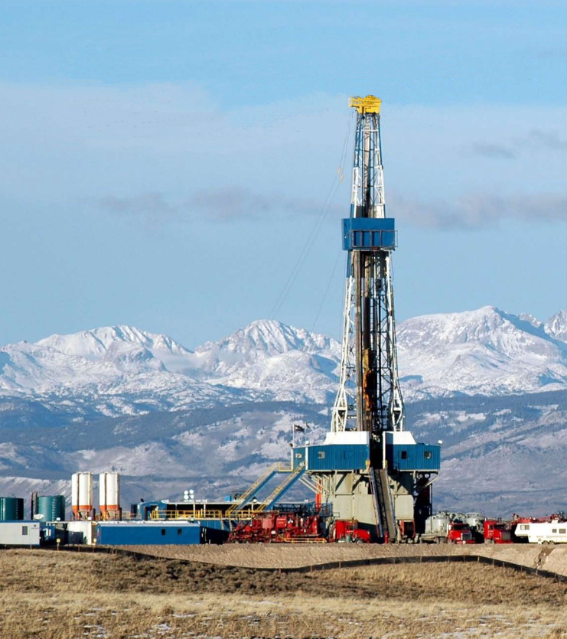
Oil & Gas (Point and Nonpoint) Workgroup
Co-leads: Jeff Vukovich (OAQPS), Tom Moore (WESTAR & WRAP)
Schedule: calls on 2nd Monday at 12:00 pm Mountain Time
Wiki: http://views.cira.colostate.edu/wiki/wiki/9180
Participation: members

Slide 19
Oil & Gas (Point and Nonpoint) Workgroup
Inventory status:
  aiming toward 2016 beta in Oct 2018
  beta projections by end of 2018
Approach
  sorting through point and nonpoint /
  upstream and midstream sources
  review of point data – June and July
  discuss projection methods and identify
  projections subgroup – July
  results from state nonpoint direct reports and EPA nonpoint tool run – August/September
  approve and implement projection method – August and Sept.
Status
  relying on OAQPS run of nonpoint tool
  attempting to retain linkage between reported emissions across a range of state programs to projected emissions by SCC/NAICS
  gathering documentation on point sources

Slide 20
Onroad Mobile Workgroup
Co-leads: Julie McDill (MARAMA), Alison Eyth (EPA)
Schedule: Calls 3rd Thursday at 2:00pm ET
Wiki: http://views.cira.colostate.edu/wiki/wiki/9181
Status of the 2016 Beta Inventory
  2016 emission factors compatible with 2014v2 available
  Beta version will include state-submitted updates to activity data: VMT, vehicle population (VPOP), hoteling hours
  Summary reports available: ftp://newftp.epa.gov/Air/emismod/2016/alpha/2016fd/reports/onroad

Slide 21
Onroad Workgroup: Beta Data Status
2016 VMT received from:
  Colorado, Connecticut, Georgia, Illinois, Maryland, Massachusetts, Michigan, New Hampshire, Pennsylvania, Virginia, West Virginia, Wisconsin, Clark County, NV and Pima County, AZ
2016 VPOP received from:
  Georgia, Maryland, New Hampshire Pennsylvania, West Virginia, Wisconsin, and Pima County, AZ
No 2016 hoteling hours received but some updates to truck stop locations received
Rep. county changes from Connecticut and Maryland
  Will take effect in v1.0, not in beta
2023 and 2028 activity due by June 30
  Received from Connecticut, New Hampshire, Ohio

Slide 22
Onroad Workgroup: 2016 beta
Approach
  Some VMT and VPOP data must be converted to SCC-level
  Quality assure the SCC-level data using maps, spreadsheets
  For hoteling: Review hoteling hours with states and determine if adjustments should be made to allocation within or between counties
Milestones
  By late July: Run SMOKE-MOVES with updated 2016 activity using existing 2016 emission factors compatible with 2014NEIv2
  August:
    Prepare 2023 and 2028 activity data and 2028 emission factors
    Review 2016 emissions and run SMOKE-MOVES for 2023 and 2028
  September: review 2023/2023 emissions
  Expected release date: early September
  Expected projection inventory date: late September

Slide 23
Onroad Workgroup: Inventory Versions
Alpha: 2016 emission factors with activity data projected using state+urban/rural factors
Beta: 2016/2023/2028 using state-submitted activity data, where available
V1: 2016/2023/2028 with activity and age distributions updated based on new CRC VIN-decoding projects
  Will require new runs of MOVES and SMOKE-MOVES

Slide 24
Nonroad Mobile Workgroup
Co-leads: Rebecca Simpson (Colorado Department of Public Health and Environment), Sarah Roberts (EPA OTAQ)
Schedule: Calls on 4th Thursday at 3:30pm Eastern
Wiki: http://views.cira.colostate.edu/wiki/wiki/9179
Status of the 2016 Beta Inventory: MOVES2014b will be run later in the summer, to generate the beta nonroad inventory and projections

Slide 25
Nonroad Mobile Workgroup
Approach: the forthcoming MOVES update, MOVES2014b, will be used to generate the 2016 beta nonroad inventory and projections. Alpha inventory was generated by running MOVES2014a for 2016, using 2014NEIv2 inputs.
Status: MOVES2014b will be run later in the summer. The work group will concurrently develop updated model inputs for v1 (e.g., refining the surrogate data used to allocate state-level equipment populations to counties).
Milestones
  Expected release date for 2016 beta and projections is September 2018

Slide 26
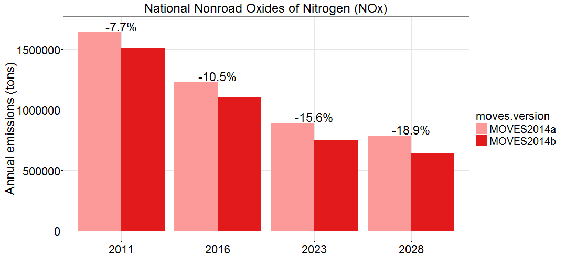
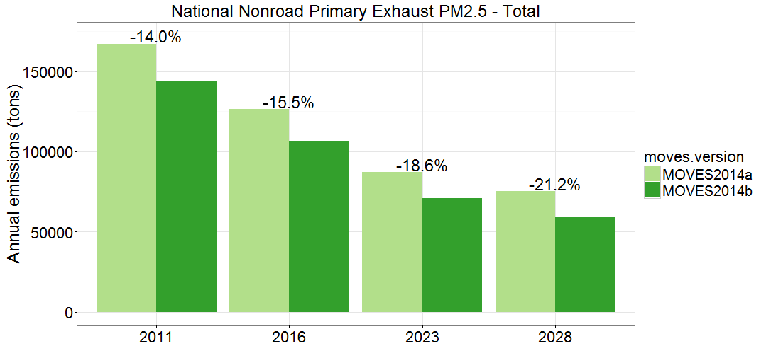
Nonroad Mobile – MOVES2014b
MOVES2014b improves estimates of nonroad emissions
  Updates engine population growth indices, Tier 4 engine populations and emission rates, and nonroad diesel sulfur levels
  MOVES2014b nonroad emissions are generally lower than MOVES2014a, but impacts of the update will vary by location and equipment sector
Please see the work group wiki for more information about MOVES2014b

Slide 27
Rail Workgroup
Lead Mark Janssen (LADCO) & ??
Schedule: Calls 3rd Thursday at 11:00am ET
Wiki: http://views.cira.colostate.edu/wiki/wiki/9182
Status of the 2016 Beta Inventory
  September 2018
  2017 NEI estimates by October
  Will include SMOKE Linkproc format for link-based processing

Slide 28
Rail Workgroup: 2016 Beta Status
Working with Federal Rail Administration link data.
Building link level estimates for Class 1 Line Haul (~85% rail NOx emissions); similar to traditional methods
Yard estimates are out for update from Class 1 railroads (~5% of NOx).
  Complete upgrade from past inventories where data are from 2007 and too old to keep rolling forward.
  May need state help filling in gaps (August). Asking for 1 volunteer from each MJO.
Class 2/3 and commuter rail estimates will go out for review this week (~10% of NOx).
  Looking for fuel-use by railroad. Primary focus on diesel commuter rail.
  Company specific Fleet Mix and link level also possible.

Slide 29
Commercial Marine Vessels Workgroup
Lead Mark Janssen (LADCO) & ??
Schedule: Calls 3rd Tuesday at 2:00PM ET
Wiki: http://views.cira.colostate.edu/wiki/wiki/9176
Status of the 2016 Version 1 Inventory
  January 2019
  EPA will build 2017 NEI estimates for Ocean going (Category 3) vessels for December deadline
  Will include SMOKE Linkproc format for link-based processing

Slide 30
CMV Workgroup: Approach
OTAQ finishing draft power model to calculate Class 3 large vessel power.
OTAQ is also working on building tools that read AIS data and do some spatial attribute checking
OAQPS has a work assignment to build the 2017 NEI inventory for marine from AIS. This will include Category 1 and 2(Great Lakes/Rivers) and Tugs at ports.
Committee will use these tools/methods to generate 2016 estimates in parrallel

Slide 31
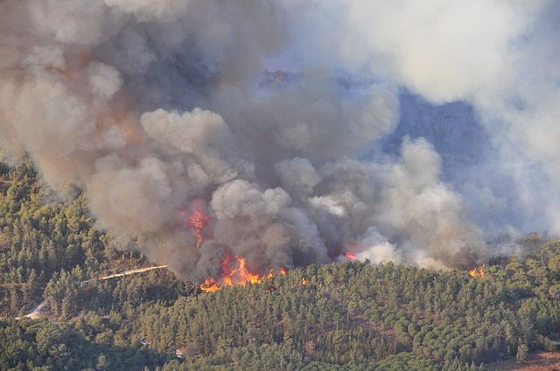
Fires Workgroup
Co-leads: Jeff Vukovich (OAQPS), Tom Moore (WESTAR & WRAP)
Schedule: Generally calls on Wed. or Thurs. early in each month at 12:00 pm Mountain
Wiki: http://views.cira.colostate.edu/wiki/wiki/9175
Participation: members

Slide 32
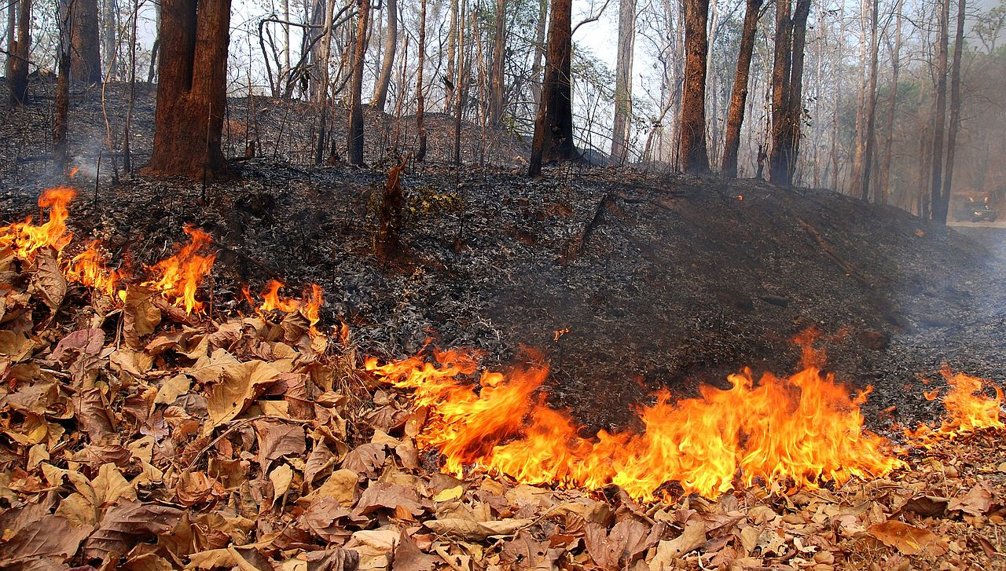
Fires Workgroup
Inventory status:
  aiming toward 2016 beta in Oct 2018
  no beta projections planned
  working to have alternate future fire scenarios with v1
Approach
  reviewing activity inputs (acres, fire type) to EPA-run SmartFire tool
  working to understand emissions estimates
    Reduce/eliminate double-counting
    Some states reporting emissions directly
    Rx fire in forests and grasslands
    Agricultural/grassland fire emissions method not yet resolved
  some states in process of submitting state-specific data
Documentation to follow
  leverage contractor support in WESTAR/WRAP region

Slide 33
Biogenics Workgroup
Co-leads: Jeff Vukovich (USEPA), Doug Boyer (TCEQ)
Schedule: Calls on 3rd Tuesday at 3:30pm Eastern
Wiki: http://views.cira.colostate.edu/wiki/wiki/9172
Google drive: https://drive.google.com/open?id=1ulLmJPQ1WkOnsi6_g2nkHLWfqJEw4RSU
Workgroup consists of one MJO (WRAP) and state and local agencies (TCEQ, GA, CARB, AZ, AL, MT)
Guests have included MEGANv3 developers

Slide 34
Biogenics Workgroup: 2016beta
Approach
  Provide both BEISv3.61 and MEGANv3 emissions
  No future-year projections
Status
  BEISv3.61 emissions provided for 2016alpha
    Simulation conducted at USEPA
  MEGANv3 default annual simulation completed by TCEQ
    Performing analysis and comparisons with BEIS3
      Includes very active participation by TCEQ, GADEP and CARB
      QA reports and graphics in Google drive folders
    Frequently communicating with MEGANv3 developers
    Land use and Stress algorithm investigation
  Comparing vs. isoprene flux measurements

Slide 35
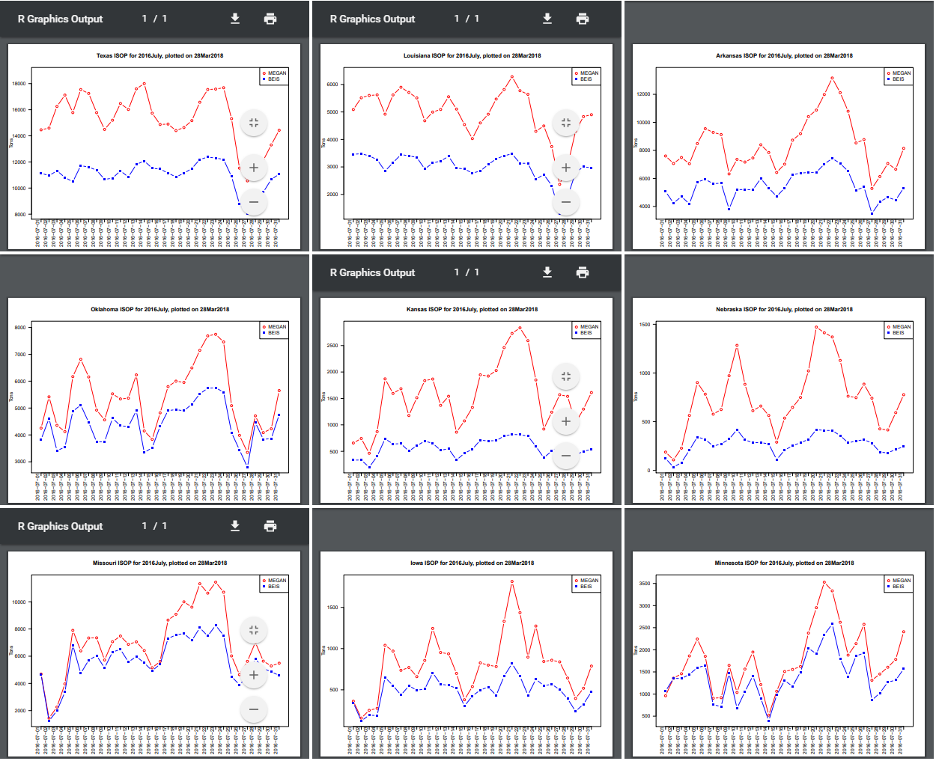
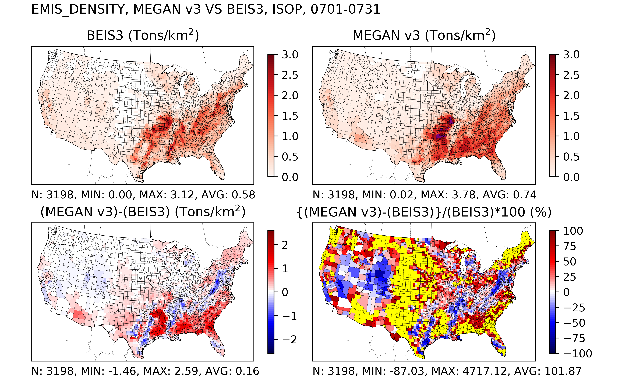
Biogenics Workgroup: Sample analyses

Slide 36
Biogenics Workgroup: 2016beta
More status
  Investigating possible land use updates (AZ)
    More likely for 2016v1
  Need air quality modeling simulations using both sets of emissions
Milestones
  Expected review date: tentatively through Aug 31
  Expected release date: Aug 31 or whenever AQ modelers can use the biogenic emissions datasets
  Expected projection inventory date: None planned

Slide 37
Modeling Workgroup
Co-leads: None, yet
Schedule: late 2018
Wiki: http://views.cira.colostate.edu/wiki/wiki/9190
Objectives:
  Gather, test, and prepare the emissions data platforms created by each of the inventory sector workgroups for use in air quality modeling.
  Produce an air quality modeling platform for modeling 2016 and projection years.

Slide 38
Modeling Workgroup: Tasks
Testing and Platform Development
  Assess availability of 2016 meteorology and boundary conditions
  Modeling protocol and platform creation
  SMOKE modeling
  Data validation
Platform Packaging
  Create an emissions modeling package with data and software needed to prepare the emissions for air quality modeling
  Develop an approach (and document) how to customize the base emissions modeling platform
Documentation and Evaluation
  Provide feedback to inventory sector workgroups on their documentation
  Model performance evaluation of the 2016 base modeling
  Create best-practices guidance for using the Collaborative data for modeling

Slide 39
Inventory Collaborative Next Steps
Workgroups will be prioritizing their work to produce beta version of the 2016 inventory by mid-summer; projections to 2023 and 2028 by late summer
Quarterly outreach calls by the Collaborative to report out on progress
Next outreach call: September 20 at 12:00 Eastern

Slide 40
Inventory Collaborative Wiki
These slides, answers to the questions posed during this webinar, live workgroup wikis, documentation, calendar:
http://views.cira.colostate.edu/wiki/wiki/9187

